Slide 1
GenAI-powered Software Engineering
CSCI 7000-011
Tue/Thu @2pm
Danny Dig
Notes:
I am so grateful. I know the academic semester is over, yet you are still here to learn and grow professionally. This shows the amazing quality of people that you are. The future ahead of us is bright because of people like you. It’s an honor to be in a community with you.
My name is Danny Dig, I am a computer science professor at U of Colorado, doing an industry sabbatical at JetBrains Research.
I am so excited to be here and explore together How is AI shaping Programming. Many are asking Is AI going to replace programmers? Or is it the beginning of a new way of doing things that will increase our productivity? How can you, the PhD students who are inventing tomorrow’s technology join forces with us at JetBrains so together we can go further?
For today I prepared some unique content for you.
Today I present three refactoring projects we’ve been working on for the last couple of years at JetBrains Research with my PhD students and JB colleagues. I invite us on a journey to see how we are leveraging the powerful static analysis in the IDEs along with LLMs to bring a fresh perspective on Refactoring powered by GenAI. The synergy between AI and the static analysis in the IDE is much greater than either of them when taken alone. I hope to inspire you with ideas so you take a similar approach with your research.
At VU ASK:
How many people have been using an IDE? Which IDEs?

Slide 2



Do not edit How to change the design
What comes to your mind when you hear 'Generative AI for SE'?
The Slido app must be installed on every computer you’re presenting from

Slide 3
Today’s goals
What is GenAI for Software Engineering: practice and research examples
Discovery: learning about each other (Family Occupation Recreation Motivation)
How can I be successful in CSCI 7000-011?
Notes:
Today’s goals
ASK: Have you received the welcome email that I sent yesterday?
The purpose of today’s class a discovery journey. I get to learn about you, you get to learn about me and where I come from and and by the end you will find out how you can be successful in this class.
You will see how this class is different than most of courses you took in the CS department.
You will be able to decide for yourself: is this class for me?
And equally important, you will find answers to the question: How can I be successful in this class. I want you to be successful in this class and I want every single one of you to get an A.

Slide 4
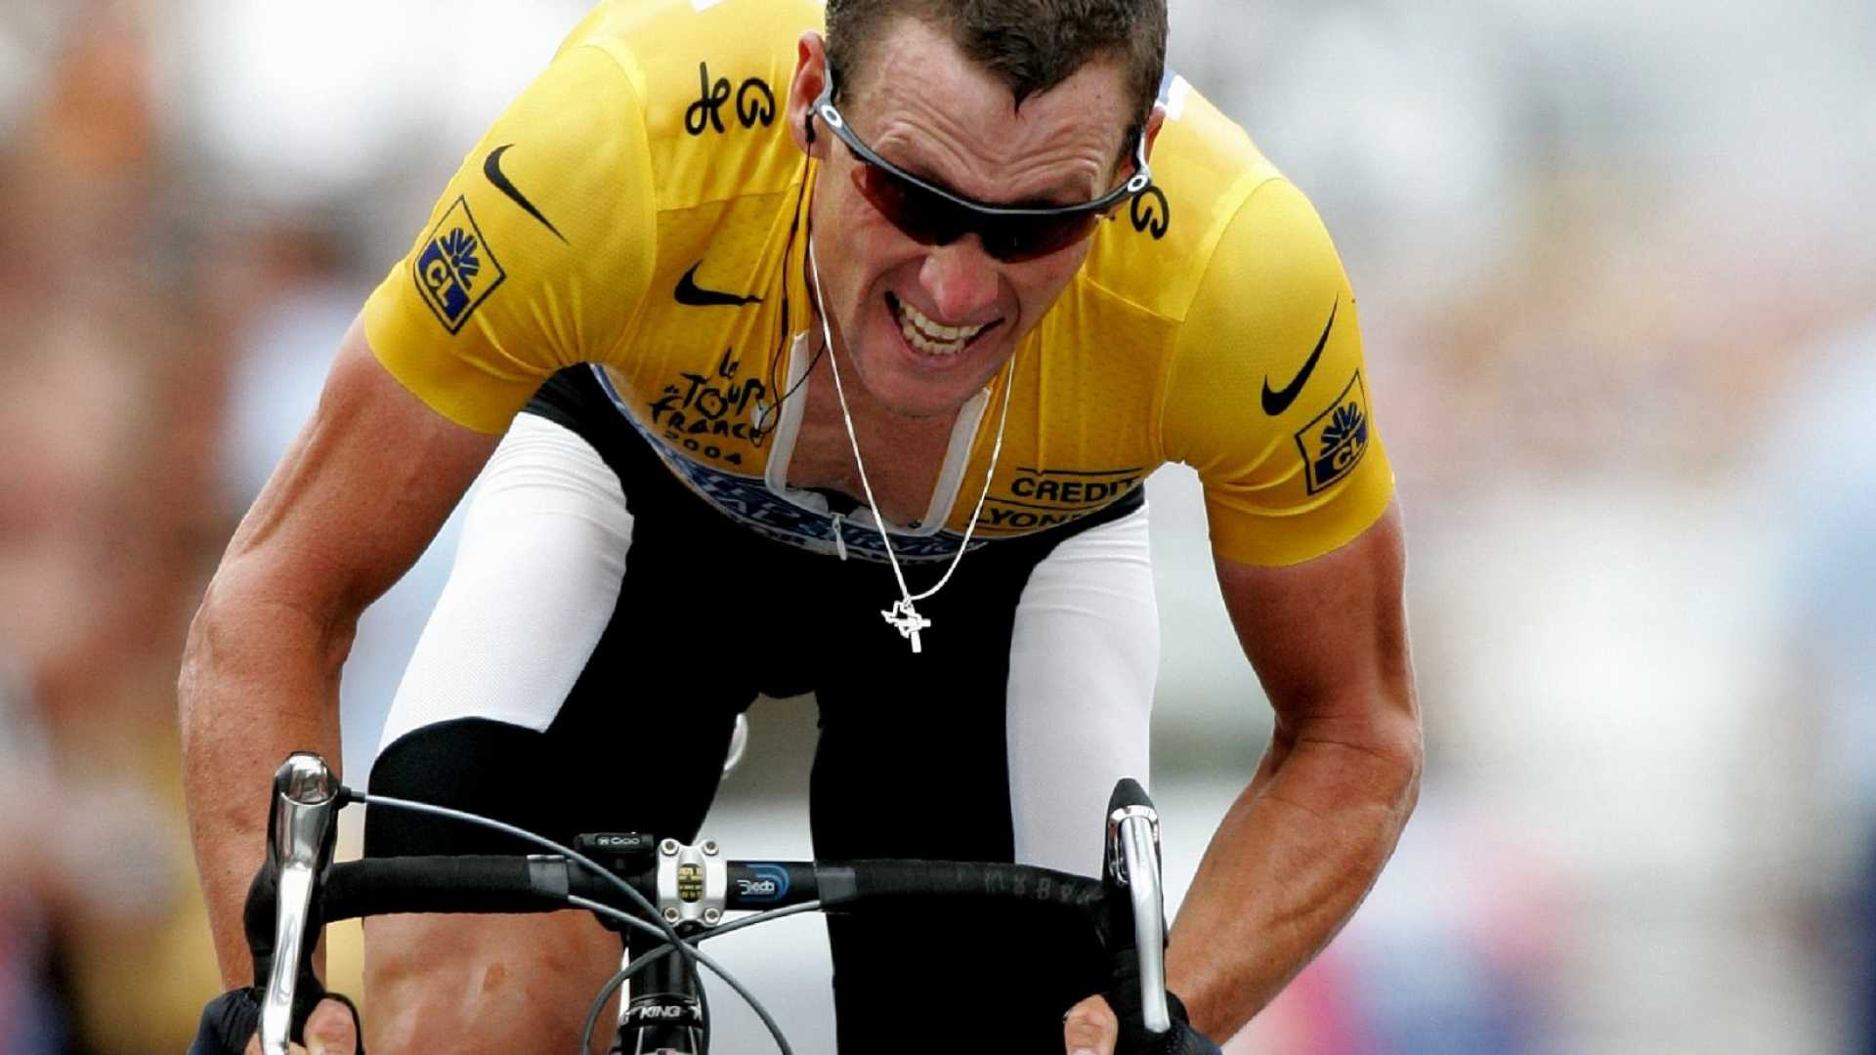
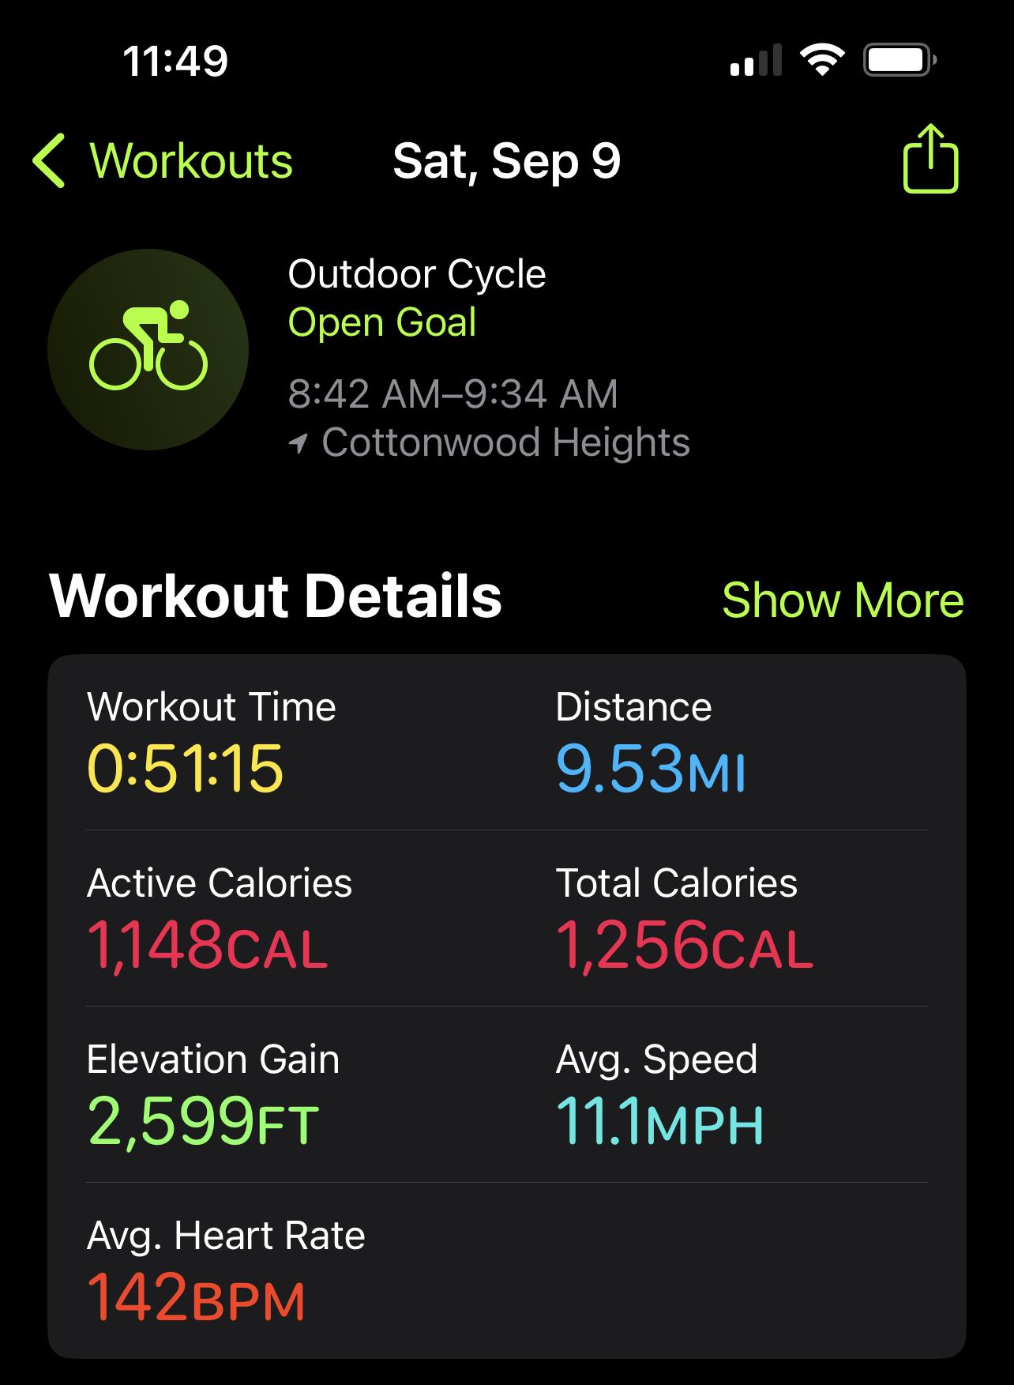
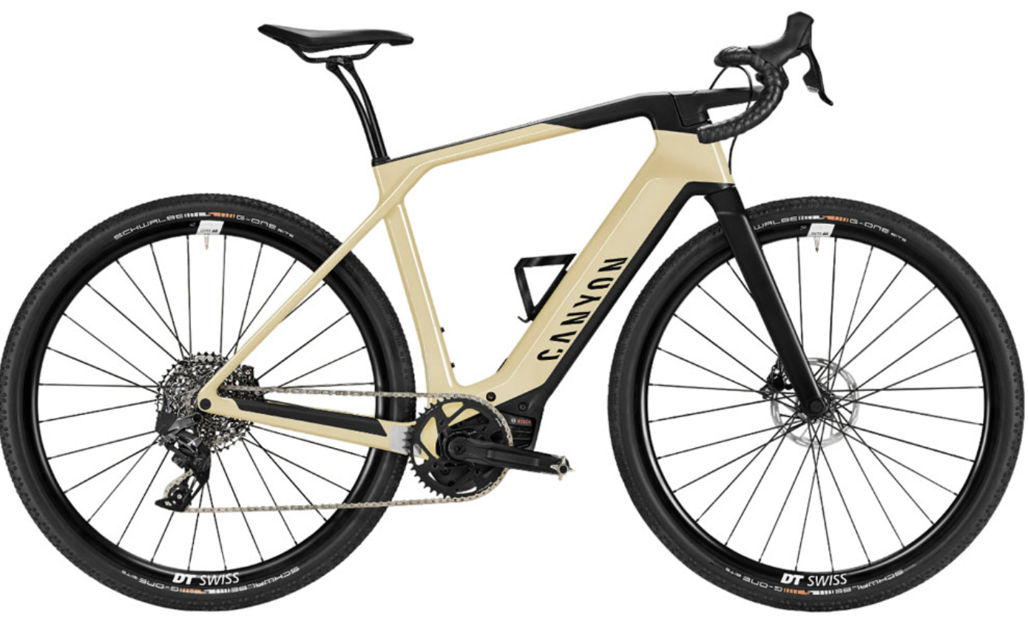
Assistant augments our capacity
85 Nm, 500 Wh
Notes:
When Mauricio took me to the VU this morning, we came by bike. I see that everyone rides bikes in the Netherlands, which is a wonderful way to get around. Amsterdam was made for bikes: everything is flat.
In contrast This is a typical bike ride for me during the weekends.
CLICK
I’ve taken a break from road cycling for the last 8 years, because of a bike accident that resulted in a severe brain concussion. But as we moved to Utah for my industry sabbatical at JetBrains and we live close to a Canyon, I decided to get back into road cycling. This is a summary of a typical ride I do during weekends as I am cycling up the canyon.
CLICK
I want to point out that while the distance was just under (8km / 5 miles) one way, this is going up a steep canyon where my elevation gain was 800 m / 2600 feet.
If you look at my body, it does not strike you that I look athletic like Lance Armstrong. My body likes food too much. On this particular ride up in the canyon, I was passing seasoned cyclists.
While they were grunting, I had a big smile on my face. My secret sauce was the tool that I use for the job: an electric-assist bike.
CLICK>
While I did get a good workout (look at my heart rate), the electric assist felt like I had a personal assistant, Lance Armstrong pushing hundreds watts of power on my pedals alongside me. Now I no longer hate the steep climbs in the canyons, actually I prefer rides where there is a lot of elevation gains as I get to enjoy the ride up the mountain and the amazing views, and I like riding down the mountain at high speed.
Something similar to this is happening in the world of programming..

Slide 5
9 hardest things programmers do
Source: Elizabeth Churchill – UX Director @ Google
Writing tests
Writing documentation
Implementing functionality you disagree with…
Working with someone else’s code
Dealing with other people…
Estimating time to complete a task
Explaining what I do (or don’t do)
Naming things
Notes:
Recently I attended a wonderful seminar by Elizabeth Churchill, director of UserXperience at Google.
Based on their research at Google with tens of thousands of software developers, Elizabeth shared a list of the 9 hardest things that programmers have to do.
Now I would say these are not the hardest in the sense they are rocket science, these are the hardest in the sense that programmers do not want nor like to do them.
Professional software developers know that it is good to Write automated tests, it is good to write documentation, it is good to explain what or why they are doing, it is good practice to give good names to coding entitites, yet they don’t do a good job at these tasks.
I like to call these the 9 hills that programmers need to climb. Similar with my bike ride up the Little Cottonwood Canyon, instead of working harder we need to work smarter.
If these things are hard for professionally trained software engineers, you can imagine how much more difficult they are for novices and computing enthusiasts.
The IDE already helps with some of these tasks.
ASK: But how can we do even better.
This is exactly where GenerativeAI helps programmers do the things they find hardest to do.

Slide 6
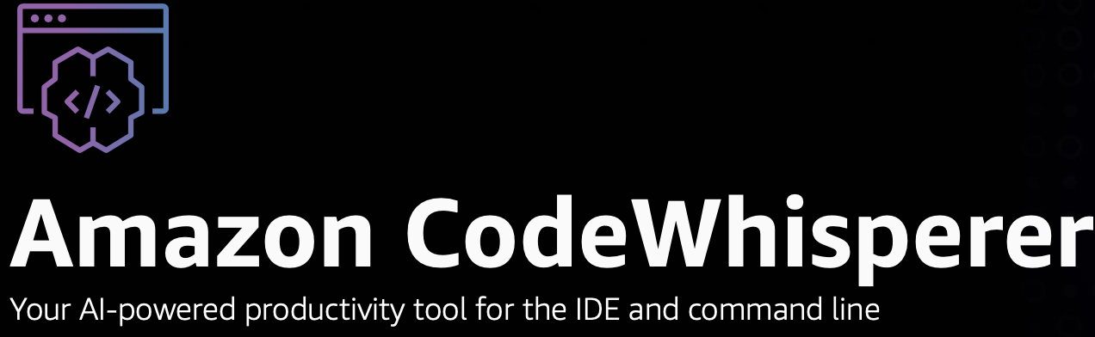
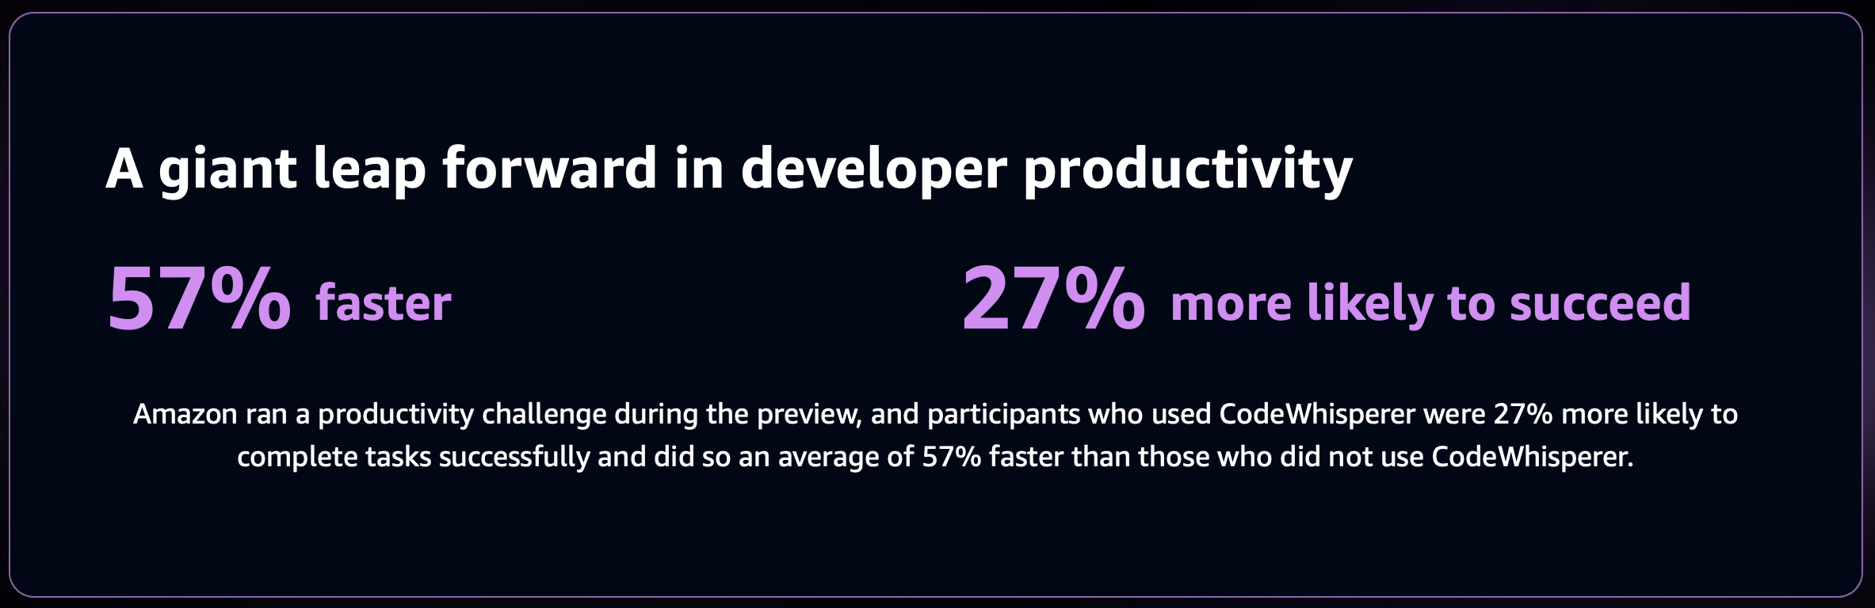
GenAI increases programmer productivity
Not displacing programmers, but making programmers more productive
Notes:
we entered a new era when Gen AI Instead of displacing programmers, it transforms regular programmers into superhuman, more productive programmers.
Amazon CodeWisperer is their AI Assistant solution for programmers. Their study found that programmers who used CodeWisperer were 57% faster than participants who did not use it.
I believe GenAI also helps novice programmers mature into expert programmers. In the same study, participants who used CodeWisper were 27% more likely to complete tasks successfully than those who did not use it.
Let’s look at some examples.
======
ASK: Please raise your hand if you have ever used a GenAI powered tool like ChatGPT, Google’s Gemini, Claude or a similar service?
ASK: which service did you use?
=======
Ask: Raise your hand if you are using an IDE, example Cloud9, PyCharm or IntellijIDEA, VSCode, AndroidStudio. If you have been using IDEs for programming, please type in the chat which ones did you use?

Slide 7

Do not edit How to change the design
Have you used any AI-powered tools in your coding projects?
The Slido app must be installed on every computer you’re presenting from

Slide 8
Do not edit How to change the design
Which GenAI tools and services did you use for programming?
The Slido app must be installed on every computer you’re presenting from

Slide 9
AI explains Runtime Errors
Programmers spend more time reading code than writing code
Notes:
Generative AI are rapidly transforming the landscape of software development tools. I am showing exciting features in a product at JetBrains called AI-Assistant. We currently support more than 20 features that benefit from AI Assistant, and the number of AI-assistant powered features is growing every month.
It is well known that programmers spend more time reading code than writing code.
ASK: what are some ways that you used in the past (before AI) to understand a runtime exception from your program?
Just this morning I was having breakfast with an educational researcher who is based in the industry, and she was telling me about how much time novice programmers spend understanding exception stack traces.

Slide 10
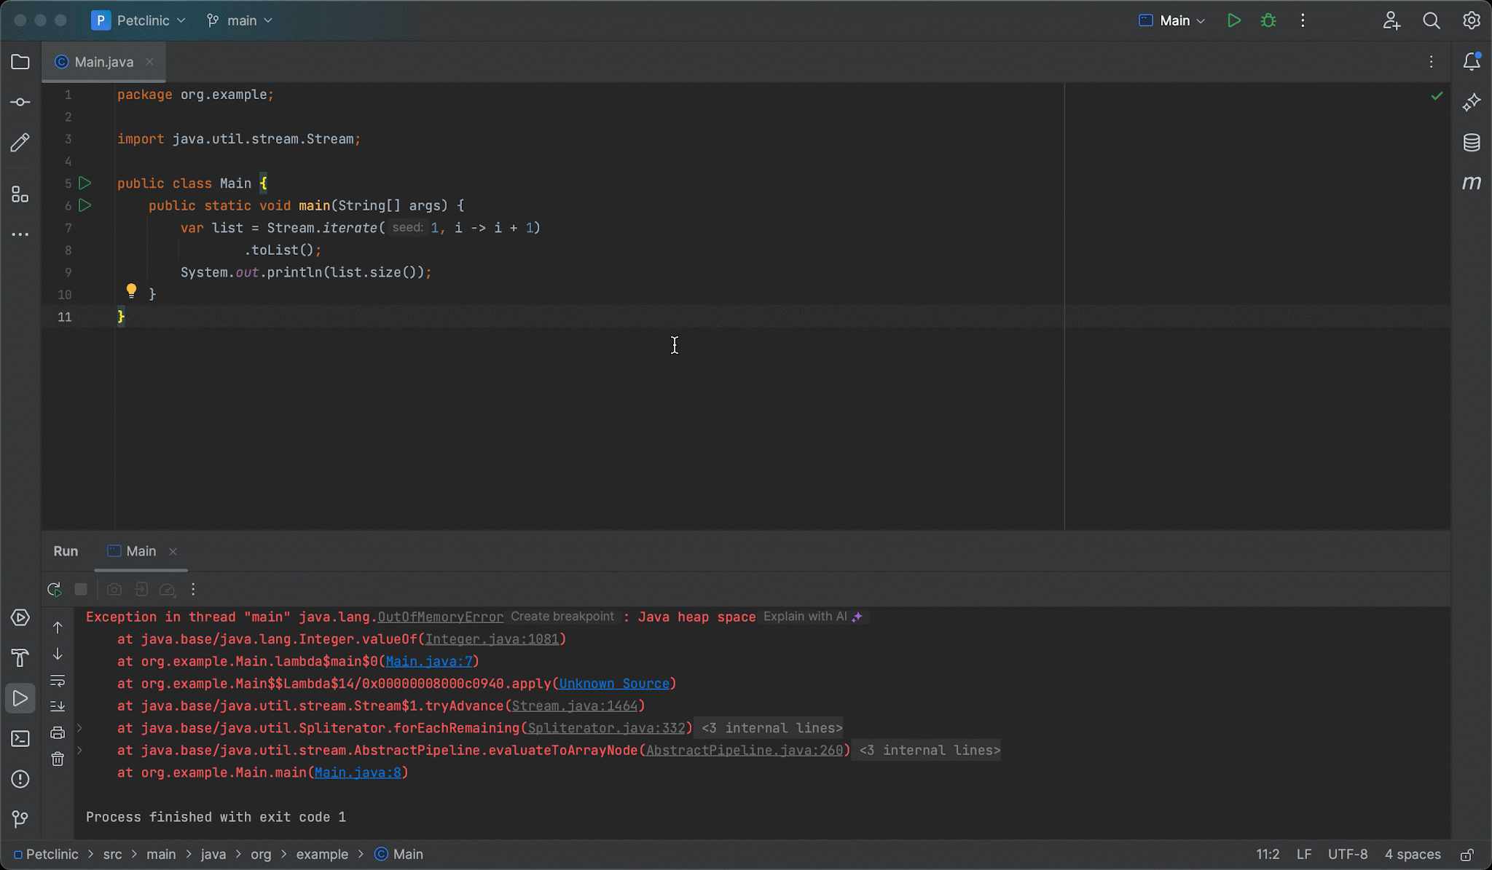
Notes:
For runtime errors shown in the console, the IDE now allows you to get AI explanations for those errors. Click on “Explain with AI”, and the explanation for the error will be shown in the AI Assistant tool window.
In this example, a student wrote an infinite loop which generates objects until it causes the JVM to eventually run out of heap memory. The AI assistant explains what is the root cause of the problem and what is the code responsible for this and even suggests a fix for this problem by adding a stop condition, so the stream ends producing elements once it reached 1M.
I am personally excited about the applications of these 2 features in CS education, particularly in our Intro to Computing classes. These are large classes that usually require a high number of TAs. The TAs can barely cope with many questions that students who are new to computing have. Imagine how AI assistant will lift up some of the load from our TAs and will help students learn programming faster. Will the AI assistant completely replace the TAs? I don’t think so, but it would make their life easier.

Slide 11
AI suggests names
Programmers don’t spend enough time giving intention revealing names to code entities, though it is crucial for code readability
Notes:
Let’s look at another example where AI helps programmers.
I'm aware We are in London here, the home of shakespeare. What's in a name? That which we call a rose by any other name would smell just as sweet.” William Shakespeare uses this line in his play Romeo and Juliet to convey that the naming of things is irrelevant.
But when it comes to programming, Shakespeare was wrong.

Slide 12
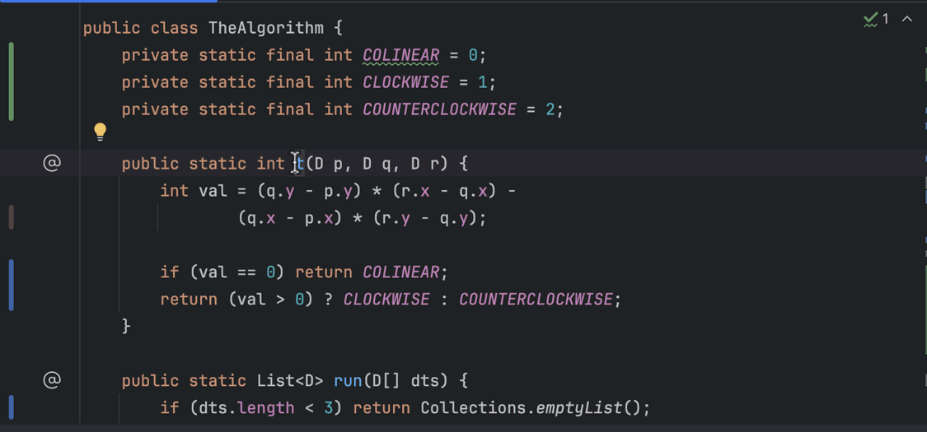
Notes:
Coming up with good intention-revealing names is is crucial for code readability, this saves programmers reading documentation and they can infer the intent of that programming element just by reading its name.
But coming up with good intention-revealing names is hard work. No wonder that programmers don’t always spend a lot of time thinking about good names.
When you rename a Java, Kotlin, or Python declaration, the AI will suggest name options for the declaration, based on its contents.

Slide 13
Multi-file changes
Programmers fail to propagate changes consistently
Notes:
Let’s look at one more example. Propagating the same changes consistently in the whole project is tedious work. So a useful feature is: Multi-file changes.

Slide 14
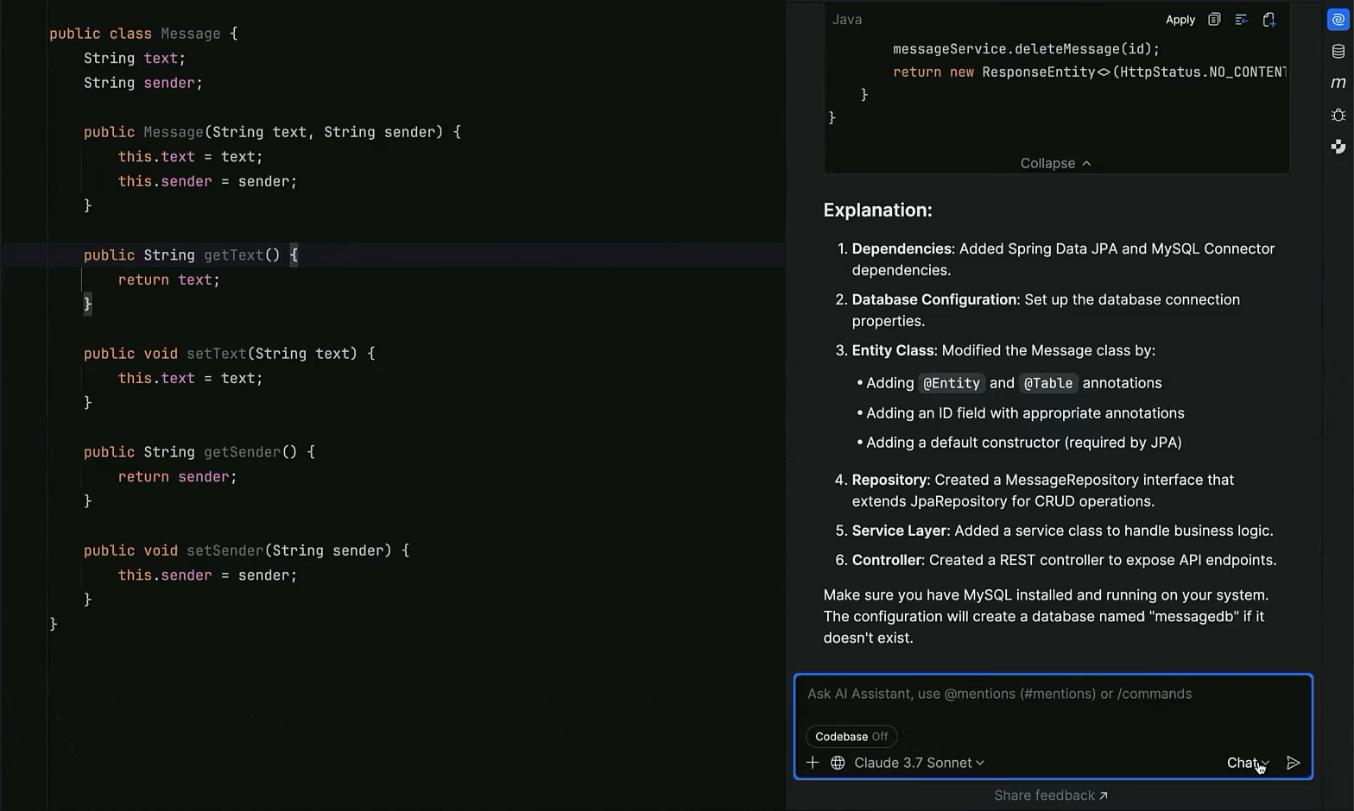
Notes:
Use AI to make changes across multiple files at once. The AI suggests necessary changes and uses retrieval-augmented generation (RAG) to locate the most relevant files to apply them to.
In this example, the programmer asks AI to add database store management to several files.

Slide 15

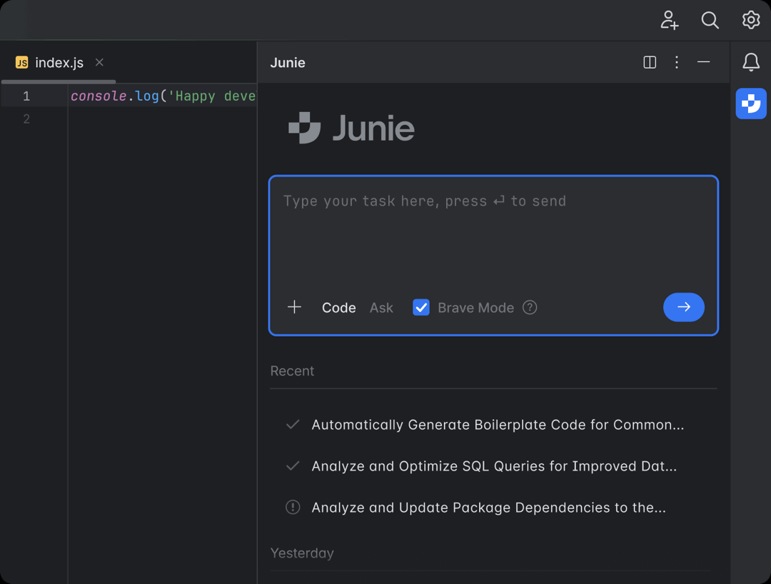
Smart coding agent in the IDE
Lighten programmer’s load
Notes:
Earlier this morning we discussed about Agentic platforms. I am happy to announce that now programmers who use JetBrains IDE can interact with Junie, an AI agent developed and trained by JetBrains. It supports the whole workflow: it analyzes the intent of the programmer specified in a requirements document, it creates a plan, is aware of the code structures available in a project, it invokes several tools in the IDE on the user’s behalf, it generates code, generates test cases, runs test cases, etc.
In this example, the programmer asks to generate a project that uses computer vision libraries to track and count objects.

Slide 16
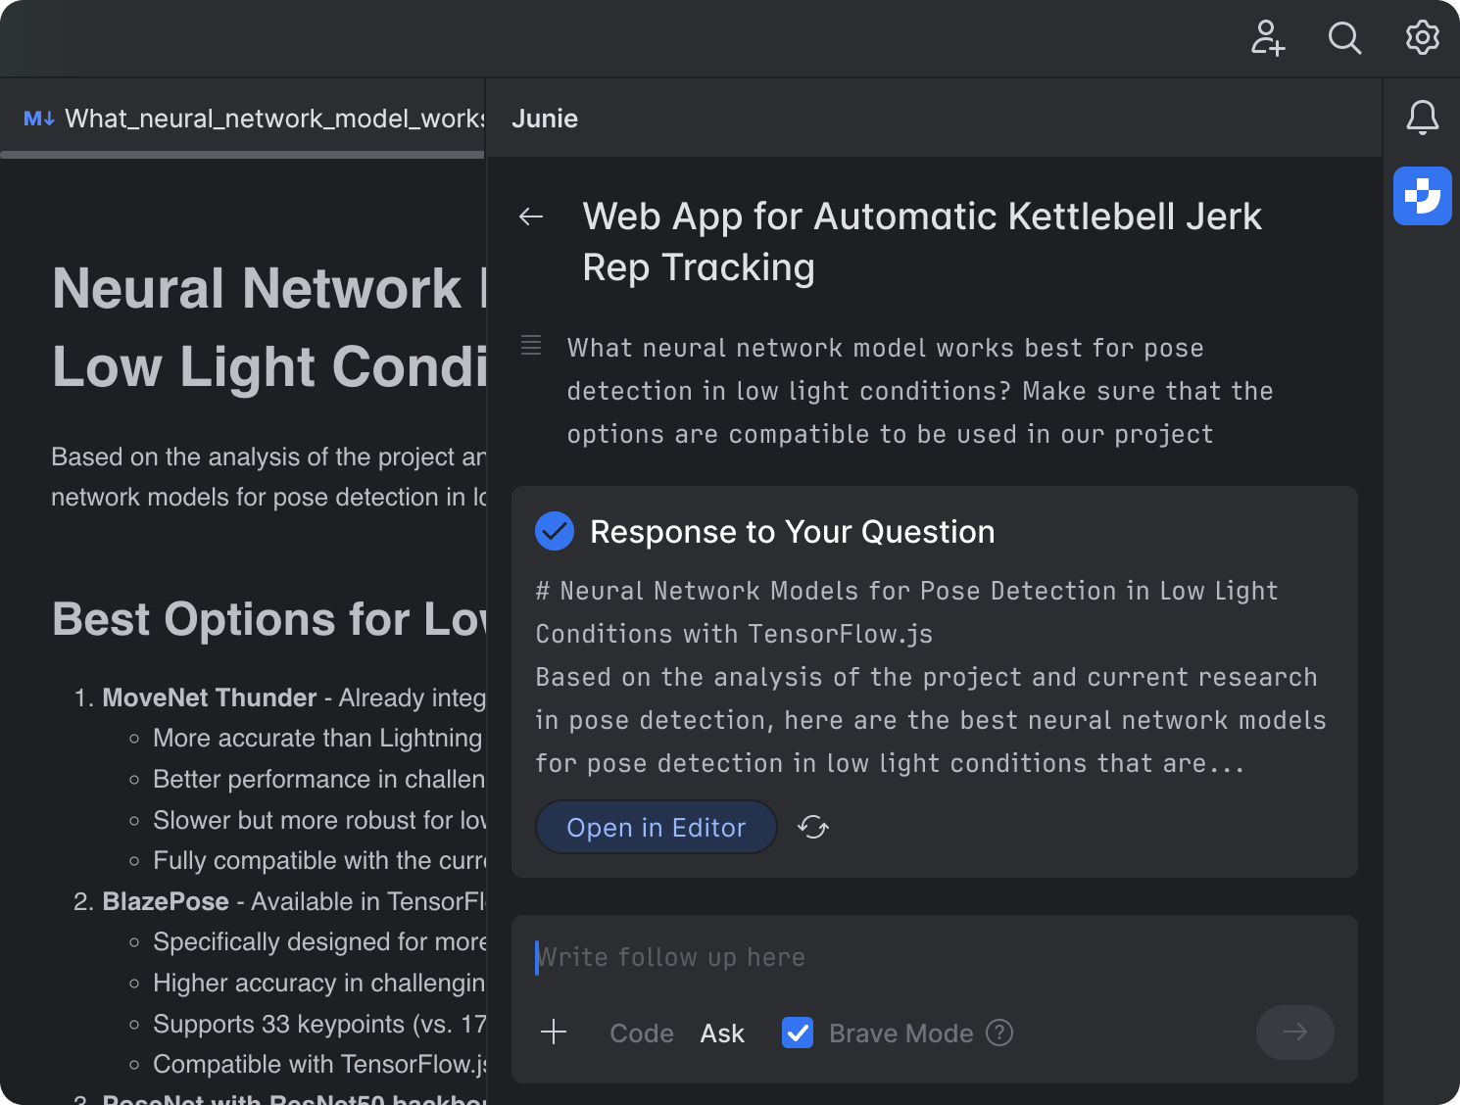
Code and ASK mode
Lighten programmer’s load
Notes:
In the spirt of Interactive Development Environments, Junie has Two modes of operation: code mode and ask mode
code mode to execute tasks, with Junie writing and testing the code for you.
Switch to ask mode to pose questions, collaborate on plans, and brainstorm features and improvements.

Slide 17

Do not edit How to change the design
Which GenAI feature would you find most useful in your work? Please rank.
The Slido app must be installed on every computer you’re presenting from

Slide 18
Examples: GenAI-powered SE Research
Notes:
Let me switch now to the second part of my talk: I will give an overview of the work my PhD group is doing in the area of AI-powered Automated Refactoring.
We see huge potential in solving developer experience and code quality problems at the intersection of LLMs and IDE.
Today I present three refactoring projects we’ve been working on for the last couple of years at JetBrains Research.

Slide 19

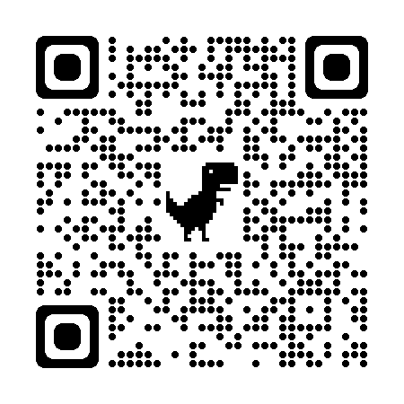

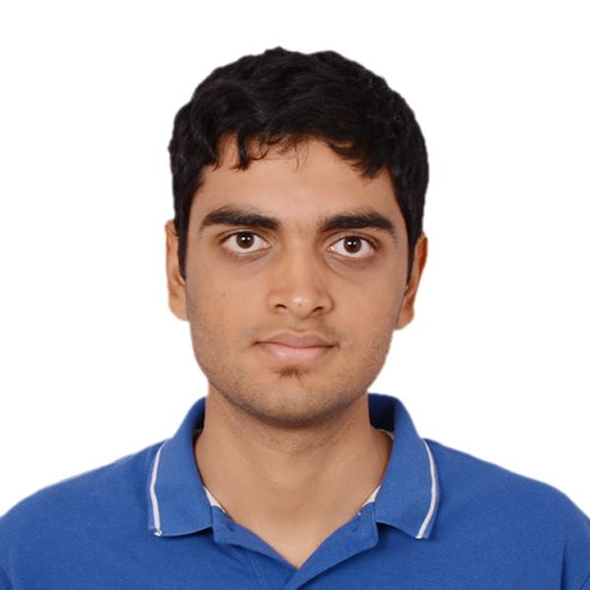
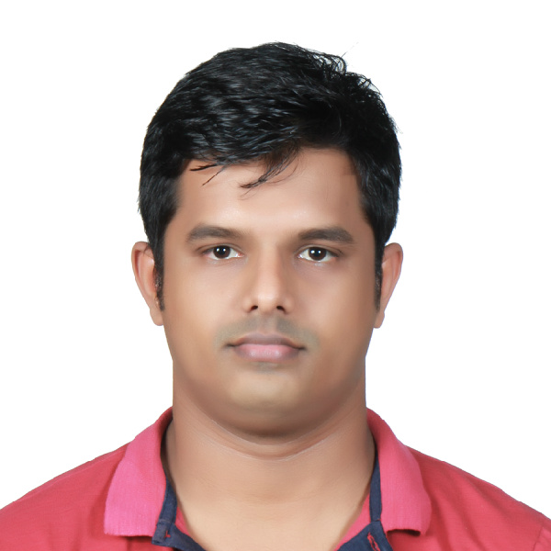




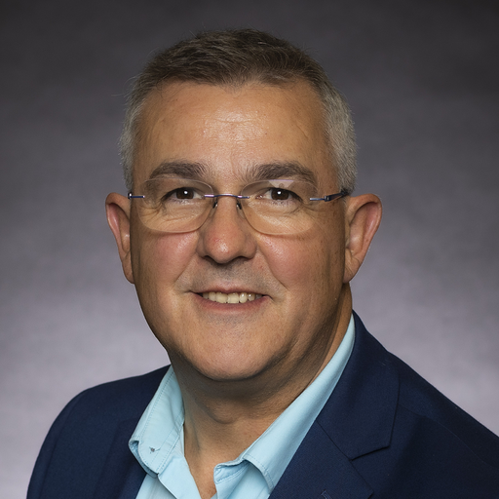



Next Generation Refactoring: LLM Insights and IDE for ExtractMethod
Danny Dig
Dorin
Pomian
Abhiram
Bellur
Egor
Bogomolov
Timofey Bryksin
Malinda
Dilhara
Zarina
Kurbatova
Andrey
Sokolov
Notes:
we started this project in the beginning of 2023.
The first project we worked was to use LLMs for splitting up large methods. This projects was kicked off around the time when Gen-AI like ChatGPT became popular, and we had many learnings from it.

Slide 20
Executive Summary:
IDE + LLM + Human >> Sum of the individual parts
Extract Method Refactoring: Splitting up large method (for modularity, reuse, …)
No suggestions from IntelliJ, though Execution is fully automated
Previous research tools generate suggestions that do not align with developers
LLM’s create wow effects! but also have a high hallucination rate – 59.2%
Tame Hallucinations, non-determinism
Evaluating quality
By replicating thousands of OSS refactorings, EM-Assist outperforms previous SOTA (Recall is 53% vs 39% other tools)
User study - 18 JetBrains devs, 94% suggestions positively rated
EM-Assist aligns with how expert developers perform extract-method.
”These suggestions made me look at this code with new eyes, and I will refactor it.”
Notes:
Our major takeaway from this project - combining LLM + IDE + Human was better than each individual part.
<CLICK> We used LLMs to suggest extract method refactoring - splitting up methods for reuse/modularity.
<CLICK>
IntelliJ cannot suggest this refactoring, but it has strong execution powers when told what to do. Additionally, we saw that many research tool (capable of suggesting) did not align with the way developer performed this refactoring.
<CLICK>
That’s where our work comes in. We built EM-Assist to address these issues.
We learned that LLMs can create wow effect - but also have a high rate of hallucinations.
<CLICK>
So, we found ways to tame hallucinations, and also the inherent non-determinism.
<CLICK>
How do we evaluate the quality of suggestions? First, we replicate thousands of refactorings performed in OSS, then user study.
This leads us to conclude that EM-Assist aligns with the way developers refactor their code.

Slide 21

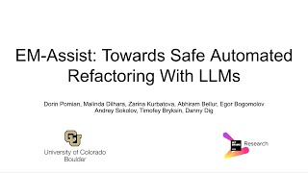
Demo: EM-Assist

Slide 22

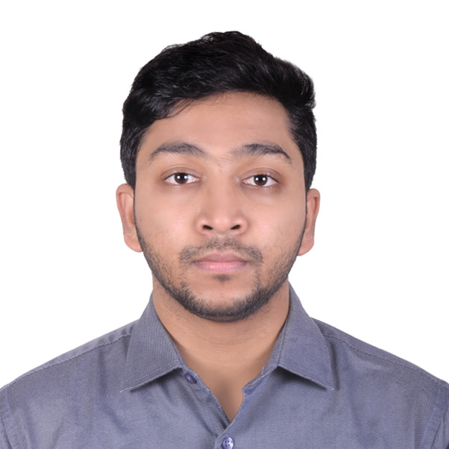

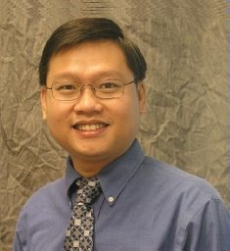
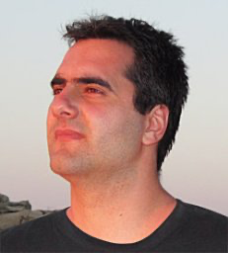
LLM-Powered Move Method Assistant
NEC Laboratories
Abhiram Bellur Mohammed Raihan Ullah Danny Dig
Fraol Batole
Tien N Nguyen
Nikolaos Tsantalis
External Collaborators
Notes:
TODO: add the pictures for the other collaborators, including people from JetBrains
This lead of to work on a more complex refactoring - moving a misplaced method to a better host class.
This refactoring is more challenging because project wide scope.
Work done with external collaborators Fraol, Nikos, Tien, ….
This paper was just accepted to ICSME'25 and we will present in NZ in September, and you are the first ones to see it.

Slide 23
Executive Summary
Move method refactoring: relocating a misplaced method.
IDE - No suggestions, but complete execution of the refactoring.
Vanilla LLM solution: High hallucination rate - 80%
Project Level Understanding achieved:
Refactoring aware RAG.
LLM + Vector embeddings + IDE
Evaluating quality:
By replicating OSS refactorings, outperformed previous SOTA by 1.7x - 2.4x
30 participants used MM-assist for 1 week, 82% gave positive rating
Notes:
CLICK MM is about relocating misplaced methods to suitable target classes
<CLICK>
Again, intellij doesn’t provide suggestions, but can execute the refactoring if triggered.
<CLICK>
Challenges: project wide scope.
Even higher rate of hallucinations, LLM on its own.
How did we achieve project level understanding? We performed a refactoring aware RAG, by using static analysis in the IDE and vector embeddings from models.
How do we evaluate the quality of suggestions?
We replicated OSS refactorings - and match exactly what developers did. This is 1/7-2/4x better than previous SOTA.
Also performed a user study with 30 developers.

Slide 24



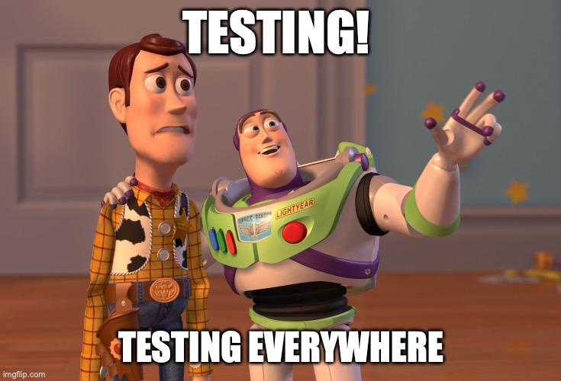






Software Testing Research @JetBrains
Objective: Develop new approaches to support developers and testers in their software testing tasks
Projects
Testing AI features
LLM-based &
Search-based Unit Test Generation
Metrics:
Compilation rate
Line/branch coverage
Language-agnostic LLM-based Test Generation
Automatically Reproducing Reported Crashes
2
1) TestSpark paper: https://arxiv.org/pdf/2401.06580
2) Test Wars: A Comparative Study of SBST, Symbolic Execution, and LLM-Based Approaches to Unit Test Generation [ICST’25]
Notes:
Software Testing research team’s main objective is supporting testers and developers in testing tasks with AI
Moreover, the team explores ways to help developers and testers to test and evaluate their AI-based features.
Some of the notable projects of this team is:
1) TestSpark: an Open-source unit test generation IDEA plugin for Java and Kotlin. LLM-based test generation for Java and Kotlin, and local search-based test generation for Java (using EvoSuite). The plugin is available for public use, it is an open-source research prototype, and external contributions are welcome to make it better
2) Implementing a language-agnostic test generation feature in Fleet’s AI Assistant.
3) Implementing and designing end-to-end testing pipelines for AI-based features.
For example: implementing evaluation pipelines for test generation feature inside AI Assistant and collect metrics such as compilation rate and structural coverage.
4) Automatically reproducing crashes reported by users with the help of AI

Slide 25
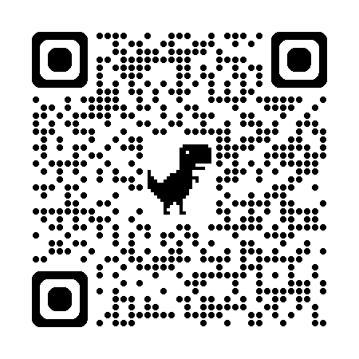
AI Agents and Planning @JetBrains
Objective: advancing technologies around AI agents with the focus on locality
Infrastructure:
Platform IDEFormer
Research:
RL to tune models for Environment Setup
Distillation for on-device models for SWE-agents
Agents:
Debugging
Environment Setup
"Debug Smarter, Not Harder: AI Agents for Error Resolution in Computational Notebooks" {EMNLP 2024
EnvBench: A Benchmark for Autonomous Environment Setup
Notes:
AI Agents and Planning team: The main objective is to design and build agentic solutions that execute many of the 2000 commands/tools in the IntelliJ IDE.
The team has developed a platform called IDEFormer, which supports Agents calling various tools from the IDE. This platform has just been open-sourced, and it enables you to write Agentic solutions for the IDE.
Here are some ongoing research:
Using RL to tune models for Environment Setup agent
Using distillation to improve on-device-sized models for SWE-agents.
We also worked on designing and deploying agentic solutions, here is one of the agents we developed: the Debugging Assistant: it’s AI agent that solves errors in Computational Notebooks. It is seamlessly integrated into Datalore, one of the IDEs from JetBrains, designed for data scientists. Our findings based on a user study show that users rely on the AI agent more than the original AI assistant and rate its error-solving capabilities higher.
It’s presented in this paper, "Debug Smarter, Not Harder: AI Agents for Error Resolution in Computational Notebooks" appeared at EMNLP 2024 System Demonstration Track! You can see a demo at this QR code.
Last, we released recently a benchmark called EnvBench for Agents that setup environments in the IDE. Feel free to use it if you work in this area.

Slide 26
Getting to know each other
Notes:
Let me switch now to the second part of our time: getting to know each other a little better
then Take 5 minutes to fill in some information about you that you want to share with me and your classmates.
Quickly introduce your name, grad program, background, expectations.
If there are few students in the class, ask them to share with others what they wrote, otherwise collect the paper and sample a few one
s.

Slide 27
Quiz: About YOU
Your name
FORM (family, occupation, recreation, motivation)
Grad Program (e.g., CS PhD, MS, MSCP, etc.), year of study, who is your grad advisor
Your background (e.g., industry experience, other CS background – such as strong SE, ML/AI, Systems, etc.)
What is the ONE Thing that you expect to take out of CSCI 7000-011?
What are your plans post graduation?
Notes:
Open a Google Doc, and then Take 5 minutes to fill in some information about you that you want to share with me and your classmates.
Quickly introduce your name, grad program, background, expectations.
If there are few students in the class, ask them to share with others what they wrote, otherwise collect the paper and sample a few one
s.
- do some cool IoT project to help society.
- expect: learn more about IoT examples, applications around the world

Slide 28
Do not edit How to change the design
What is one expectation you have for CSCI 7000-011?
The Slido app must be installed on every computer you’re presenting from

Slide 29
What are your expectations from CSCI 7000-011: GenAI for SE?
Do a cool GenAI Project that helps programmers/society
Learn about exciting GenAI Applications for SE
Exposure to research on GenAI for SE
Learn about the Challenges in building GenAI software
Learn how GenAI software differs from classical software
Notes:
ASK them to add more options here based on their expectations
Do a cool GenAI Project that helps society
Learn about exciting GenAI Applications for SE
Learn about Agents
Exposure to research on GenAI for SE
Learn about the Challenges in GenAI
Learn how GenAI software differs from classical software
..How to communicate technical material to outsiders
.. How do we conduct industry-relevant research
.. Understand limitations and opportunities of IoT
… Learn applications of IoT for human users
… Whole picture vantage of IoT, how to process IoT data
Overview of IoT applications in healthcare, and the rest of the field
Common challenges across different applications and how we approach them with reuse
…Get ideas for PhD/MS dissertation
…Learn about the Practical aspects of SE
…Learn about the Theoretical aspects of SE
….Learn about the state of the art in SE
Get equipped for being a researcher
Improve programming skills

Slide 30
Do not edit How to change the design
What are your expectations from CSCI 7000-011: GenAI for SE
The Slido app must be installed on every computer you’re presenting from

Slide 31
Course Administration
Check webpage: https://danny.cs.colorado.edu/courses/csci7000-011_F25/
Work items due before next Tue (08/26):
- Familiarize with class webpage
sign up on Piazza (all communications through Piazza, no email after this week)
Read and write critiques for two research papers (see template on webpage)
Check prerequisites: computing background (either practical experience or undergrad-level knowledge of SE, Systems, ML), please check with me after the class
Notes:
TODO: ASK: How many people have been on the webpage already?
Open the web browser and navigate through the pages, spend some time at the Syllabus
The prerequisites of this class
If you have not taken the equivalent of these classes, but have several years of professional software engineering experience, this will work well too, but come and talk with me at the end of the class.

Slide 32
CS 7000-011 is Different!!!
This class is NOT:
- an introduction to Software Engineering (take instead CSCI 5828)
- a tutorial on GenAI APIs/tools (see free resources on the internet)
- an asynchronous course (you need to participate live each class)
Notes:
This class is different from many classes you might have taken already at CU. Before we talk about what the class is, let me first define what this course is NOT:
This is NOT an introductory grad course to Software Engineering, for those students we recommend other grad courses such as Foundations of Software Engineering (CSCI 5828). This course assumes you are a competent software engineer already -- we are looking into how you can augment your current skills to include GenAI supported software development
NOT a tutorial on various GenAI frameworks and APIs: there are many free resources and MOOCs on the internet about this. Besides, these GenAI frameworks and APIs change so frequently, that even if I taught you one now, it will be obsolete in a matter of months. For Example, the IDEFormer framework at JetBrains for calling Agentic tools in the IDE already changed dramatically several times since it was open-sourced and released last May.
- NOT an asynchronous course (this is a synchronous, live class). Even though the class is offered on Zoom you need to participate live each class.
Like in real life, there are tough choices we need to make:
- If there is another class offered on campus at the same time slot at 2pm Tue/Thu like this class, you might be thinking whether you can attend the other class in person, and catch up on this class asynchronously (that would not work). Or maybe some of you might have a day job that overlaps that you If you are thinking there you have to decide, you go to school and earn an education or you go to company and make money.

Slide 33
CS 7000-011 is Different!!!
Research-based course:
- at times it would feel it is not ”organized”
- there are lots of choices, you need to select
- structure is fixed, but content is dynamic
Complete a research or industrial-novel project of your choice (teams of 4 students)
follow the steps of open-ended/risky research (proposal, fit in literature, evaluate empirically)
at the end of the term you would have produced a research paper that you can submit to conference
WHY: equips you to conduct novel R&D
Notes:
This class is different and I can guarantee that it will stretch each of you.
- At times it would feel that the course is not organized. But this is normal.
This is how graduate-level course that is truly breaking new ground in the hot research topics should feel like.
Unlike an undergrad course where all students do the same tasks that are predetermined ahead by the professor, in a grad research class there are lots of choices, and the professor will let you select what works for you.
There is a fixed structure (we all read papers, we work on research projects that have the same milestones) but the content is very dynamic
CLICK
When you form teams for projects, I do not know ahead of time what are the projects (unlike in an undergrad class where the project is pure engineering and is known to all ahead of time)
CLICK
You will follow the steps of a typical research project (which are open-ended, risk-taking projects)
CLICK
If you do high-quality research & publish your research, you are guaranteed an A in the class!!
CLICK
At times, you might feel a bit lost in the beginning as you have to discover on your own, this will equip you with the skills you need to do well in graduate school.

Slide 34
CS 7000-011 is Different!!!
Participate in live class discussion and activities.
Read 1-2 research papers for every class meeting (11 pages each, double column => total of 500+ research pages)
- later on, you choose papers that match your project
Paper Critiques: for each class meeting, for each research paper, submit before class (by 5pm previous day)
- WHY: equips you with critical thinking
Research presentation: you prepare and deliver for the selected research papers
- WHY: equips you to communicate your ideas
Notes:
Unlike in a undergrad class, there will be lots of discussions in my class. You will not be able to hide or escape, or take a mental break. You will have to actively participate in each class.
CLICK
When we read research papers, we do not know ahead of time all papers (unlike in an undergrad class where the professor knows ahead of time all lectures). A research-oriented grad course is dynamic, we choose to read papers as they are related to research project and the papers help you make progress on the research project.
CLICK
Submit your critique the day before the class (this gives the presenter a chance to add new material to help you better understand)
CLICK

Slide 35
Projects on GenAI for SE
For new grad student, project gives ideas for dissertation
For experienced grad student, project advances your research
Technological shifts/opportunities for GenAI:
- any process & tool we use in software development lifecycle (requirements, design, coding, testing, evolution)
Industrial-innovation: availability of rich data from sensors (e.g., dataset from City of Denver)
Research projects (not an app), teams of 4 people
Notes:
TODO add more specifics about Research versus Industry novel track

Slide 36
Example Transformations for IoT
What are the new transformations we need to automate?
- inspiration from explorative studies
- empirical studies to find performance or energy anti-patterns
Examples of transformations:
- candidate programs with trade-offs between performance & power consumption
- adaptation to different display technologies
- split functionality between the device and cloud
Notes:
TODO: put some thrusts from the CAREER

Slide 37
CS 7000-011 is Different! Lots of Guests
Interviews with industry thought leaders
Watch segments from leading industry events (e.g., AI Summit) or leading academic conferences
Broadcast of keynote speakers
Panel discussions
Notes:
I am not responsible for You, I am responsible to YOU. I will give you unprecedented access to people that you would never meet otherwise.
It’s up to you what you do with these resources and opportunities.

Slide 38
Testimonials
“This course was exceptionally difficult and carried a massive time requirement. I only took two courses this quarter and even then I'm not sure I was able to give either of the classes the amount they deserved because of the time requirement for this class.” [student from previous years]
“… But that doesn't mean that I'm not satisfied, have students who previously took the course convey this”
Announcements for next class:
Read the webpage, signup on Piazza
Read two papers and submit Paper Critique in Canvas (by Monday at 5pm)
Office hours: right after the class
Notes:
This class will stretch you. I just want to warn you that this class is not for the easy at heart. This is what students who took classes with me in the past years said.
CLICK read
DO: turn to the neighbor on your left and right and tell them: this class will stretch you.
CLICK read
DO: turn to the neighbor and tell them: this class is tough but that’s right, it’s just what you need now.
CLICK The work for next class: read 2 papers and write critiques
- I mentioned that 562 has a prereq 561 which is usually offered in the Fall term, but was not offered last Fall. 561 itself has as prereq 361 and 362 undergrad SE classes. To check these prerequisites that you have the background knowledge to make you successful in 563.
- We will do an in-class 2-hour quiz, similar with the exams we give in CS361/CS362. If you have taken undergrad classes in SE or you worked in the SE industry, there is not much you need to prepare for this, though you might want brush up your knowledge by looking at what we cover in our CS361 and CS362.
CLICK
Office hours right after the class, I am willing to stay and answer your questions as long as it takes.
If you are not sure whether this class is right for you, come and talk with me.
MANDATORY: the students coming from the Pathway program must stay and talk with me at the end.

Slide 39
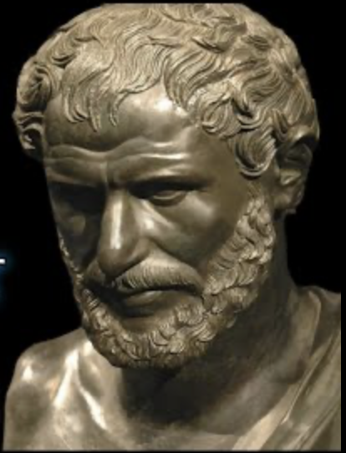
Executive Summary
Change is the only guaranteed constant
GenAI + IDE+ Human
“…Game changer! Enter the AI assistant, the great equalizer.” -Lenovo CTO
Together We Go Further
danny.dig@colorado.edu
Notes:
The Greek philosopher Heraclitus told us 2500 years ago that change is the only guaranteed constant.
Our society is going now through a seismic changes, similar in scale and impact with the industrial revolution and the information revolution transformed our society.
60% of the Jobs today did not exist in 1940. Similarly, I think AI will create new jobs and will change existing workflows for knowledge workers. The boat has already left the port, you don’t want to be left behind. That’s why you are here. I encourage you to start using AI in your workflow, and if the initial results you are getting are underwhelming, learn how to communicate better with AI (there are many resources on Prompt Engineering, RAG). The same way how we communicate differently with people based on their personality and culture, we need to learn how to communicate effectively with AI.
We are witnessing seismic changes in the landscape of software development tools.
The sum of Generative AI, smart programming environment tools and the human in the loop, is so much greater than any of these parts in isolation. This will turn programmers into superhuman-programmers
Tim Bates, the former CEO of Lenovo says “This is a game changer. Enter the code AI assistant, the great equalizer”
Together We Go Farther!

Slide 40
Bonus

Slide 41
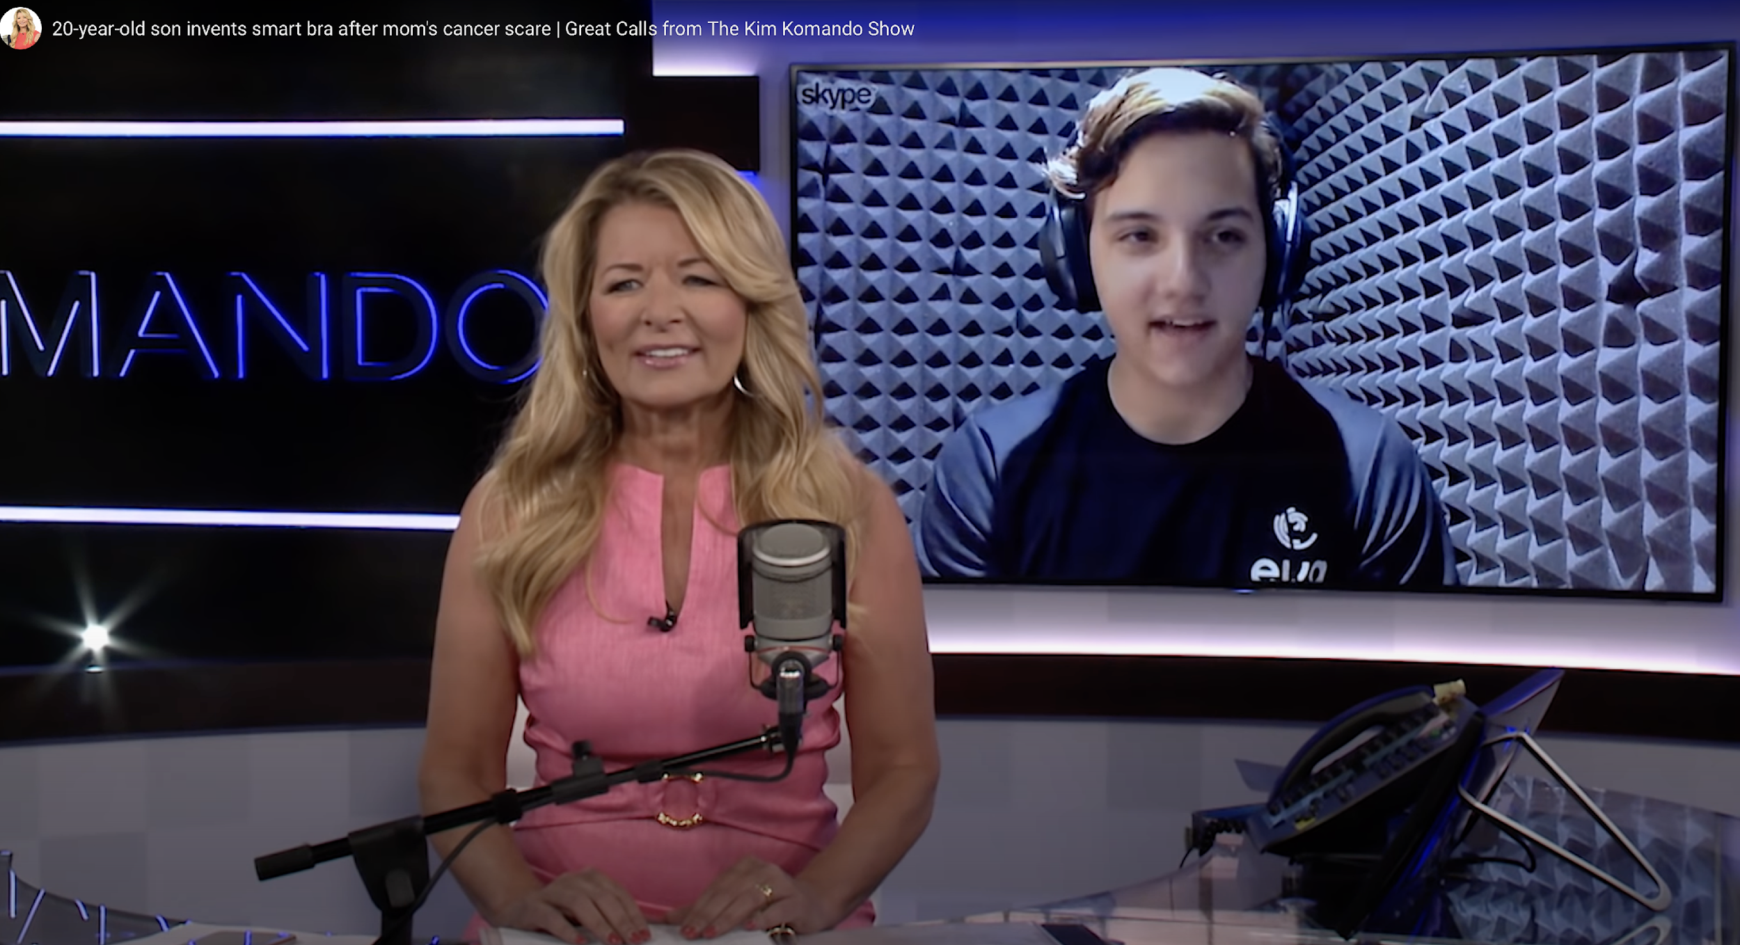
Julio Rios Cantu invents smart bra after mom’s cancer scare
Source: The Kim Komando Show
Notes:
Everyone please meet Hulio Rios Cantu: he was 13 years old when his mother contracted breast cancer. He didn’t fully understand his mom’s struggle but he watched her battle with cancer until she had to go surgery to have both breasts removed. That was enough to get this student from Mexico interested in the issue of cancer. By age 16, Hulio formed a company with a couple of friends whose mothers also almost lost their lives because the breast cancer diagnosis came too late. The statistics show that in the US alone, one in 8 women will develop breast cancer within their lifetime. So Hulio’s company created a smart bra that detects cancer early. They called their invention Eva. Hulio explains that when there is a tumor in the breast there is more blood, more heat, so there are changes in temperature.
When a woman wears this smart bra once a week, Eva can detect if warmth and blood flow are different. Eva uses biosensor and ML algorithms to predict if there is a risk, signaling to the woman to go the doctor to do a mammogram.
What’s very impressive from Hulio’s story is that him and his friends had to teach themselves ML and AI, and coding. It took them 4 years of self teaching and research.
Stories like this show the huge potential of GenerativeAI – imagine how much GenAI can accelerate the learning of coding so that entrepreneurs like Hulio can invent the future.
“Software for all and by all” is the future of humanity. Generative AI has the potential to democratize software creation, enabling individuals of all backgrounds – even 16 year olds to create software with higher reliability and quality.
========
To keep the template design consistent, please paste text from another source using Paste without formatting (right-click or menu Edit).
Please take note that presentations are intended to help the audience focus on the speaker’s words rather than distract them with detailed reading material.
Each slide should use only a handful of words to reiterate the speaker’s points using text that reinforce the speaker’s point.
Avoid inserting so much text that you have to decrease the font size.
If your text does not fit in the text placeholder, consider breaking it into 2 slides or choosing a layout with 2 or 3 columns.

Slide 42
Executive Summary
Multi-Agentic framework: Capable of planning, executing multiple refactorings
Tools: Refactoring APIs from IntelliJ
Range of refactoring capabilities:
class scope: renaming, extracts, code-modernization
project scope: extract class, move method, type change
Notes:
To evaluate EM-Assist we performed an automatic evaluation on two corpora. <UPDATE>
On an extended corpus of 17hundred ExtractMethod refactorings actually applied by open-source developers in modern codebases, EM-Assist achieved a recall rate of 53%, compared to 39% for the previous best-in-class tool that relies solely on static analysis. This *dramatic* improvement shows that EM-Assist better aligns with how developers refactor their code.
We did a usability survey with 18 professional developers from JetBrains and
They really liked the tool: 94% gave a positive rating.
CLICK> These were the comments:
”These suggestions made me look at this code with new eyes, and I will refactor it.”
<Read quote at bottom>

Slide 43

Do not edit How to change the design
How did you like this presentation?
The Slido app must be installed on every computer you’re presenting from

